Slide 1
Big-θ Growth Classes

Slide 2
Common Growth Classes
Slower
Traditional complexity theory
Slow (exponential or worse)
Fast (polynomial time)
Data science advice
Impractical
Consider with caution
Great for offline tasks
Great for online tasks
θ(c^{n})
θ(n³)
θ(n²)
θ(n log n)
θ(n)
θ(log n)
θ(1)
Faster
Notes:
There are about 7 common Big O classes that you should understand. There’s listed here from fastest to slowest.
At the bottom, O(1) are constant time algorithms - the number of steps is under a fixed bound, no matter the input size.
At the very top, we have O(e^n), which we call exponential growth. These are functions that grow so quickly, that we are limited to tiny amounts of data.
If you talk to a complexity theorist, they would normally divide this list here. Above the line are exponential algorithms, or even slower algorithms, and these would be considered slow.
Below the line are all the algorithms we call polynomial - they are O(some polynomial function). and these would be considered fast. A lot of computer science research is interested in finding ways to solve problems in polynomial time.
For a data scientist, this theoretical division isn’t enough. you should really see this as more of a continuum. Here’s some very rough guidelines to think about.
at the top, exponential algorithms are too slow, except for extremely tiny inputs.
big polynomials like n^3, might be ok, but you have to be cautious. If you have a billion rows of data, a billion cubed is 10^27, and that’s too slow for many applications.
As you get to n^2, and definitely n log n, these are great for processing data offline.
and as you get to O(log n), that’s so fast that you can use these for online processing.

Slide 3
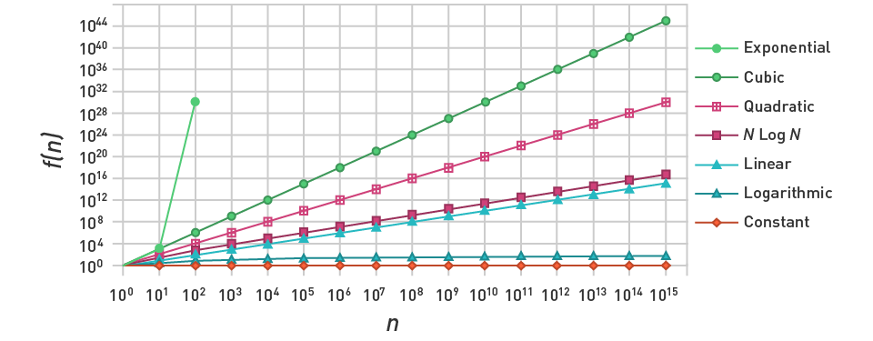
Comparison of Growth Rates
Notes:
Here’s another view of the seven common growth functions.
Both axes are logarithmic, which turns a lot of them into straight lines.
You can see that there is a clear ordering.
One thing to notice is that adding the log n barely changes the growth rate. log n is very close to a constant, n log n is almost the same as n.
One other thing to notice is that even with the logarithmic axes, the exponential curve is very different. it’s slope keeps increasing. and it will eventually grow faster than any power of n. that’s what makes exponential algorithms so impractical in most cases.
Important to develop an intuition for how quickly each of these grows

Slide 4
Big-θ Growth Classes

